Slide 1
Lenovo Web Page (E-Computer Selling)
Create By
SALIHAH
SHAFINAS
MUZAMMIL

Slide 2
Introduction
What is going on in around YOU????

Slide 3
This website will provide online business for computer product. User can see detail of computer product and also can compare product by it performance, capacity and efficiency.
Computer is importance assets in our daily life. Computer is helping us to make facilitate the daily work. Example of electronic device is computer, laptop and etc.
With internet, computer and laptop can serve web page. Most company have their own web page. With their web page, we can see their background organization, products, and etc.
Most popular business in the whole world is online business. Online business is making us order product from our own place. We can order through company web page or agent web page.

Slide 4
OBJECTIVE
What is our target….

Slide 5
Make selling activity through online web page.
Make process selling more easy, faster and effective.
Helping buyer that buy product from their house or work place.
Buyer can compare detail of product.
Easy for customer to buy because buyer only have to surf internet.

Slide 6
User Manual and Description
The way to training user….

Slide 7
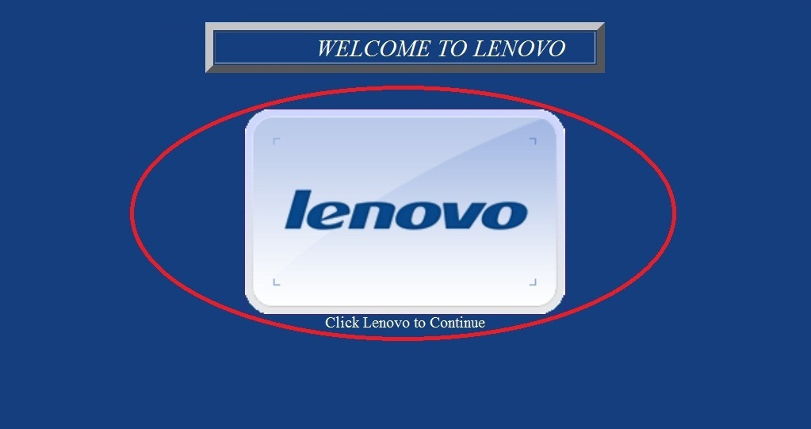
Welcome Interface
1(a)
Description
This web page is to welcome the user. This page also have background music.
1(a): link to MAIN MENU.

Slide 8
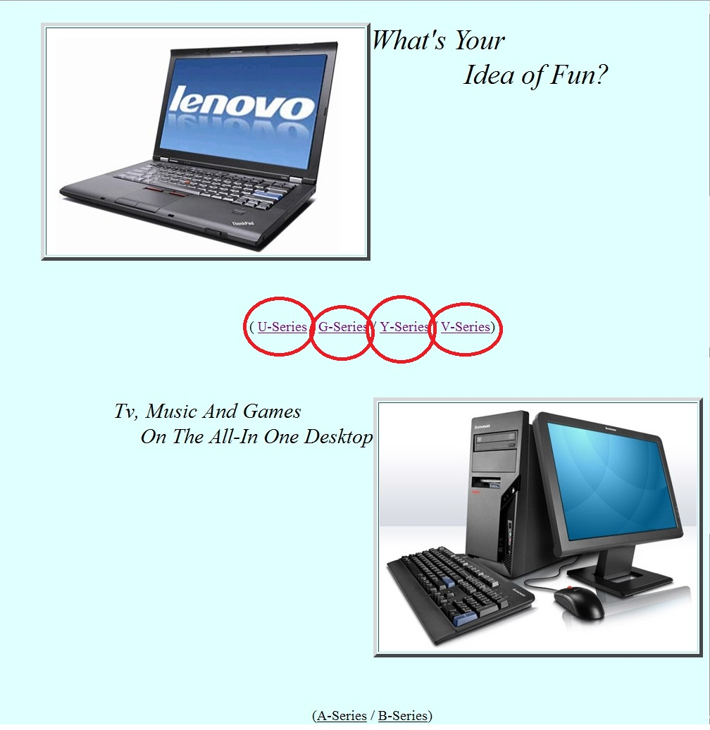
MAIN MENU Interface
2(c)
2(d)
2(a)
2(b)
Description
This web page is Main Menu. This page will link to product interface.
2(a): link to U series product.
2(b): link to G series product.
2(c): link to Y series product.
2(d): link to V series product.

Slide 9
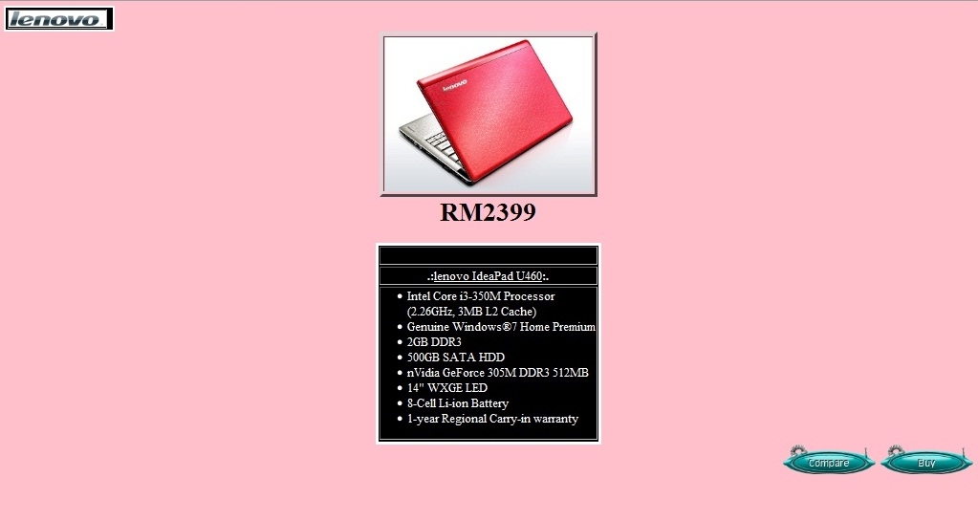
Product Interface
3(a)
3(c)
3(b)
Description
This web page is about product detail. From this page we can return to Main Menu and also have button.
3(a): click Logo Lenovo to return Main Menu.
3(b): click button to compare product.
3(c): click to buy product.

Slide 10
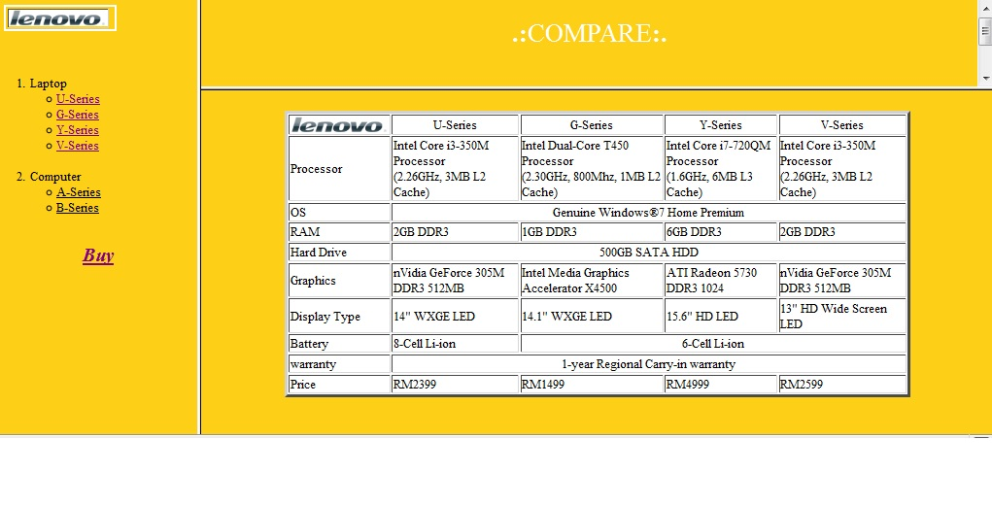
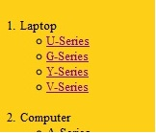
Compare Interface
4(a)
4(c )
4(b)
4(d)
4(g)
4(e)
4(f)
Description
Here you can compare the product. From this page we can return to Main Menu <4(a)> and Sub menu <4(b)> on the side of web page. In this Page also have link to buy product <4(g)>.
4(c): link to U series product.
4(d): link to G series product.
4(e): link to Y series product
4(f): link to V series product.

Slide 11
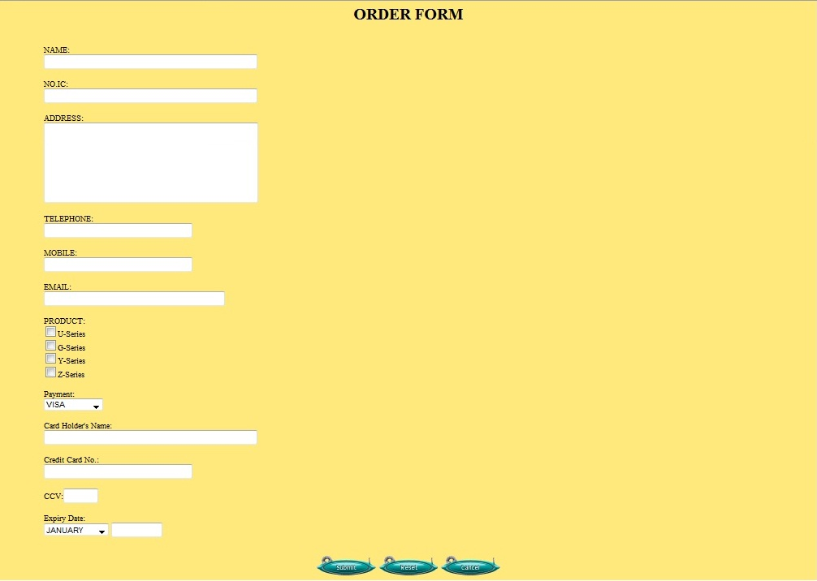


Order Form Interface
5(a)
5(c)
5(b)
5(d)
5(e)
Description
User must fill the form to complete their order. 5(a) is type of payment and 5(b) is month for expiry date using select.
5(c): click to Submit.
5(d): click to Re-fill the form.
5(e): click to Cancel.

Slide 12
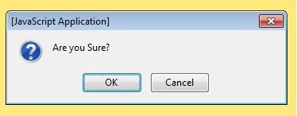
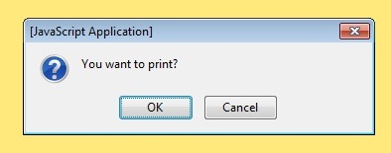
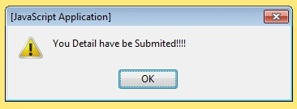
Pop-up
6(a)
6(b)
Description
This Pop-up will pop when click submit button in order form.
6(a): click to open your email app.(see 9(a)) for sent information that have been fill.
6(b): click to Re-fill the form .
Description
This Pop-up will pop after click button 6(a). This pop-up will ask for print.
7(a): click to print.
7(b): click to skip print.
7(b)
7(a)
8(a)
Description
This Pop-up will pop after click button 7(a) or 7(b) .
7(a): click to return back to main menu.

Slide 13
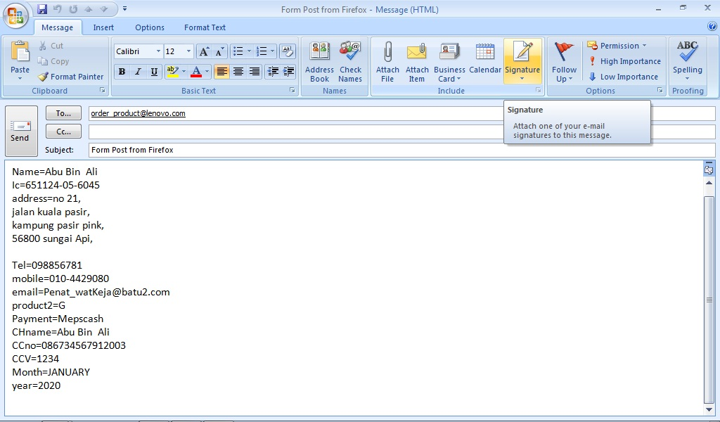
Email Application
9(a)

Slide 14
Conclusion
What can we conclude…..

Slide 15
By using this web page….
user can see detail of product
compare by it performance, capacity and efficiency.
With compare the product user can choose a good product and suitable with user.
In Additional, user can….
buy product by fill the online form
Do online payment.
Make daily life more easy.

Slide 16
THE END
We very thank for YOUR Attention
Please wait….
Let we show your how our web page work….

